Slide 1
PROFIT, LOSS & DISCOUNT
LIFE SKILLS –I
COURSE CODE : 18SSK201

Slide 2
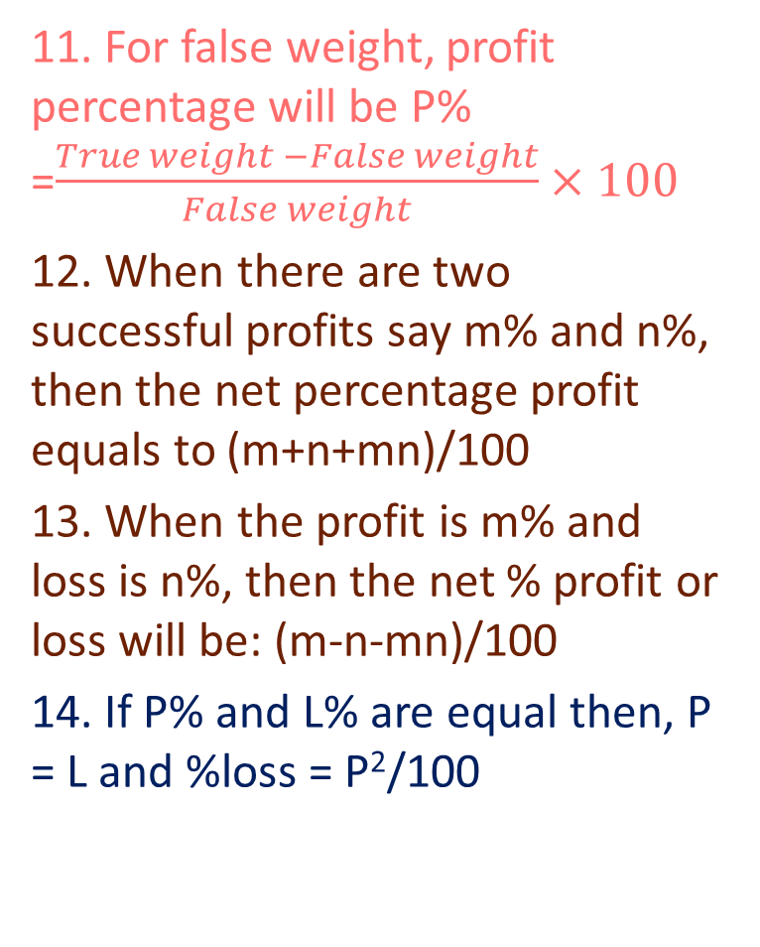
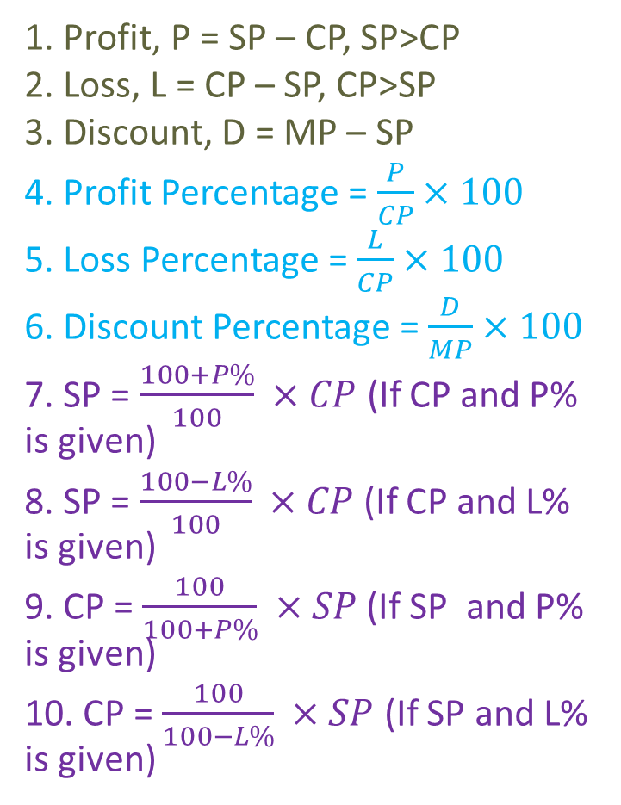
FORMULAS
11. For false weight, profit percentage will be P% =$\frac{True weight −False weight}{False weight}×100$
12. When there are two successful profits say m% and n%, then the net percentage profit equals to (m+n+mn)/100
13. When the profit is m% and loss is n%, then the net % profit or loss will be: (m-n-mn)/100
14. If P% and L% are equal then, P = L and %loss = P²/100
1. Profit, P = SP – CP, SP>CP
2. Loss, L = CP – SP, CP>SP
3. Discount, D = MP – SP
4. Profit Percentage = $\frac{P}{CP}×100$
5. Loss Percentage = $\frac{L}{CP}×100$
6. Discount Percentage = $\frac{D}{MP}×100$
7. SP = $\frac{100+P\%}{100} ×CP$(If CP and P% is given)
8. SP = $\frac{100−L\%}{100} ×CP$(If CP and L% is given)
9. CP = $\frac{100}{100+P\%} ×SP$ (If SP and P% is given)
10. CP = $\frac{100}{100−L\%} ×SP$ (If SP and L% is given)

Slide 3
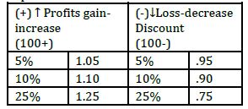
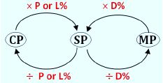
APPLICATION OF PERCENTAGE TO PROFIT AND LOSS
TWO – STEP PROCESS
Step 1 : Always write Percentage (%) terms in decimals
(see table below)
For profits add into 100 while for loss minus from 100
STEP2 – If you have to calculate SP always multiply P
(decimal) with SP
P = profit
L =Loss
D = discount

Slide 4

Find the single discount equivalent to the discount series of 20%, 10% and 5%.
Solution :
Let the MP be Rs. 100
Total price after 3 discount = $\left(\frac{80}{100}×\frac{90}{100}×\frac{95}{100}×100\right)=68.4$
Final Price = MP – Total price
$Final price=100−68.4$ = 31.6
Single discount = 31.6% on Rs. 100.

Slide 5


After getting two successive discounts, a shirt with a list price of Rs. 150 is available at Rs. 105. If the second discount is 12.5%, find the first discount.
Solution :
Let the two discounts be x% and 12.5%.
$$150×\frac{100−x}{100}×\frac{100−12.5}{100}=105$$
$$100−x=\frac{105×100×100}{87.5×150}$$
100-x = 80
x = 20%
$$MP\underset{→}{ ×D\% } SP$$
$$150\underset{→}{ ×0.875 } 131.25$$
SP = 105
Difference = 131.25-105 = 26.25
Discount% = $\frac{26.25}{131.25}×100$
=20%
OR

Slide 6


Solution :
Normal Method :
Let the CP be Rs. 100
SP = 100 + 33% of 100 = 133
MP=$\frac{100}{100−discount\%}×SP$
MP = $\frac{100}{95}×133$ = 140
Since MP>CP,
% increase = $\frac{MP−CP}{CP}×100$
=$\frac{140−100}{100}×100$
= 40%
At what percentage above the CP must an article be marked so as to gain 33% after allowing a customer a discount of 5%?
Cost price : Marked Price
100-Discount% : 100 + Profit%
100-5% : 100 + 33%
95 : 133
38
Required % = $\frac{38}{95}×100$
= 40%
OR

Slide 7
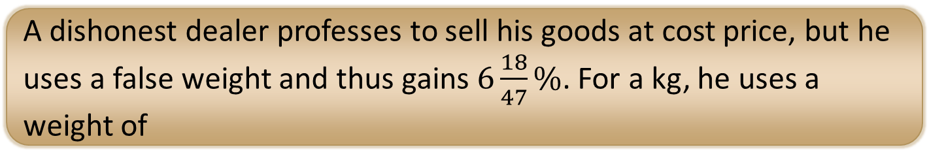

Solution :
Given, Gain % = $6\frac{18}{47}\%= \frac{300}{47}$
P% =$\frac{True weight −False weight}{False weight}×100$
For 1 Kg,
$$\frac{300}{47}=\left(\frac{1−FW}{FW}\right)×100$$
$$\frac{1}{FW}−1= \frac{3}{47}$$
$$\frac{1}{FW}= \frac{3}{47}+1= \frac{50}{47}$$
FW = 47/50
FW = 47000/50 = 940 grams.
A dishonest dealer professes to sell his goods at cost price, but he uses a false weight and thus gains $6\frac{18}{47}\%$. For a kg, he uses a weight of

Slide 8


When a producer allows 36% commission on the retail price of his product, he earns a profit of 8.8%. What would be his profit percent if the commission is reduced by 24%?
Solution :
Let the retail price be Rs. 100
Commission 36% = 36% of Rs. 100 = Rs. 36
SP = Retail price – commission
SP = 100 – 36 = Rs. 64, P% = 8.8%
CP =$\frac{100}{100+8.8}×64=58.82$
Commission reduced by 24%
Commission percentage = 36-24 = 12%
New commission = 12% of 100 =Rs. 12
SP = 100-12 = Rs. 88
P% = $\frac{88−58.82}{58.82}×100$ = 49.6
$$MP\underset{→}{ ×D\% }SP$$
$$100\underset{→}{ ×0.64 }64$$
$$SP\underset{→}{ ÷P\% } CP$$
$$64\underset{→}{ ÷1.088 }\frac{1000}{17}$$
$$MP\underset{→}{ ×D\% }SP$$
$$100\underset{→}{ ×0.88 }88$$
$$Profit\%=\frac{88−\frac{1000}{17}}{\frac{1000}{17}}×100$$
$$=\frac{62}{125}×100=49.6$$
OR

Slide 9


If a commission of 10% is given on the written price of an article, the gain is 20%. If the commission is increased to 20%, the gain is
Solution :
Let the MP of the article = Rs. X
SP = $\frac{100−10}{100}×x=Rs. \frac{9x}{10}$
CP of the article = $\frac{100}{100+20}×\frac{9x}{10}$
$$=\frac{9x×10}{120}=Rs. \frac{3x}{4}$$
New SP = $\frac{100−20}{100}×x=Rs. \frac{4x}{5}$
New Profit = $\left(\frac{4x}{5}−\frac{3x}{4}\right)=\frac{16x−15x}{20}=Rs. \frac{x}{20}$
Profit % = $\frac{\frac{x}{20}}{\frac{3x}{4}}×100=6\frac{2}{3}$
$$MP\underset{→}{ ×D\% }SP$$
$$100\underset{→}{ ×0.9 } 90$$
$$SP\underset{→}{ ÷P\% }CP$$
$$90\underset{→}{ ÷1.2 }75$$
$$MP\underset{→}{ ×D\% }SP$$
$$100\underset{→}{ ×0.8 } 80$$
Profit% = $\frac{80−75}{75}×100$
=$\frac{20}{3}=6\frac{2}{3}$
OR

Slide 10
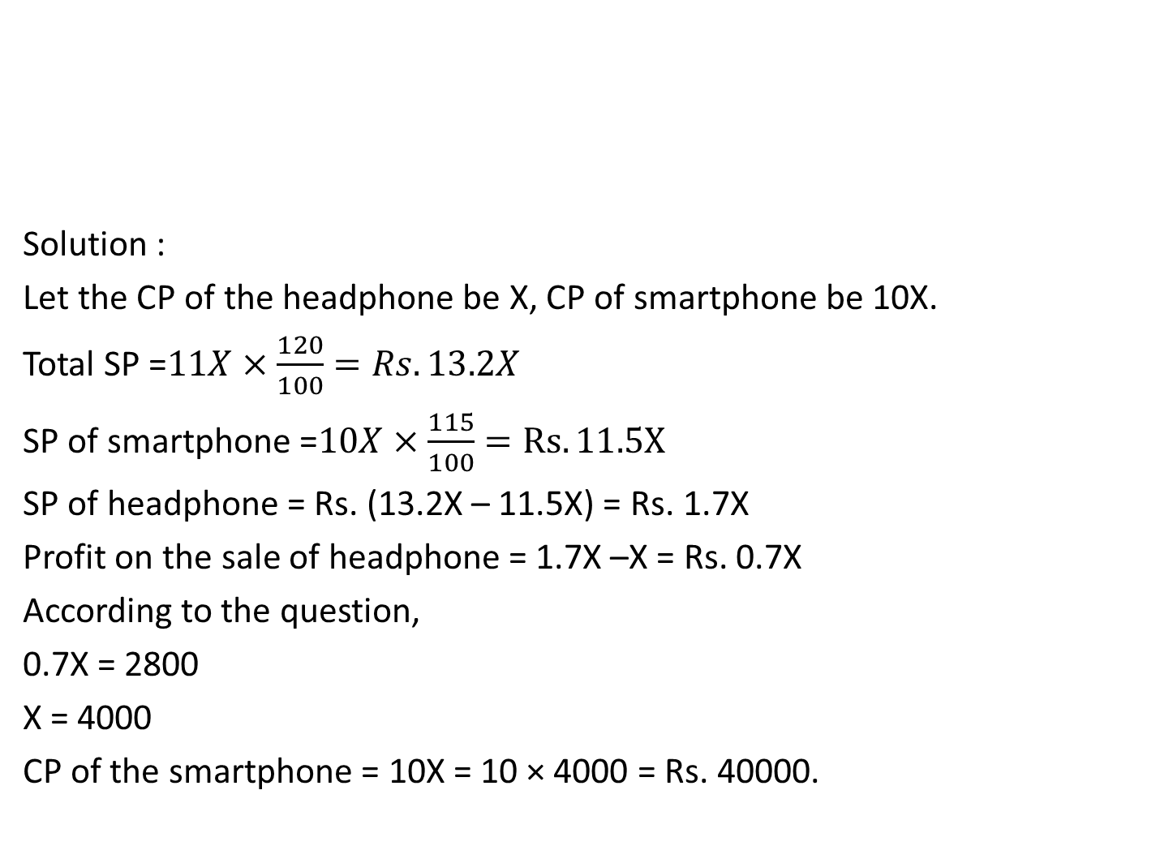
Solution :
Let the CP of the headphone be X, CP of smartphone be 10X.
Total SP =$11X×\frac{120}{100}=Rs. 13.2X$
SP of smartphone =$10X×\frac{115}{100}=Rs. 11.5X$
SP of headphone = Rs. (13.2X – 11.5X) = Rs. 1.7X
Profit on the sale of headphone = 1.7X –X = Rs. 0.7X
According to the question,
0.7X = 2800
X = 4000
CP of the smartphone = 10X = 10 × 4000 = Rs. 40000.
A smartphone costs 10 times the cost of a headphone. On selling smartphone there is a profit of 15% while the total profit on selling both headphone and smartphone is 20%. If there is a profit of Rs. 2800 on selling headphone then find the cost price of smartphone?

Slide 11


Solution :
CP of the house = Rs. 150000
SP =$\frac{105}{100}×150000=157500$
CP of Y = Rs. 157500
SP = $\frac{98}{100}×150000=154350$
Difference = 157500-154350
X gains Rs. 3150
A house worth Rs. 1, 50,000 is sold by X to Y at 5% profit. Y sells the house back to X at 2% loss. Then, in the entire transaction
A. X loses Rs. 1350 B. X loses Rs. 4350 C. X gains Rs. 3150
D. X gains Rs. 4350
$$CP\underset{→}{ ×P or L\% }SP$$
$$\left(X\right)150000\underset{→}{ ×1.05 }157500\left(Y\right)$$
$$\left(Y\right)157500\underset{→}{ ×0.98 }154350(X)$$
Difference = 3150
X gains Rs. 3150
OR

Slide 12

Solution :
Given, 20CP = XSP
$\frac{CP}{SP}=\frac{X}{20}$ 20-X (Profit)
Profit% = $\frac{20−X}{X}×100$
25 = $\frac{20−X}{X}×100$
25X = 2000 – 100X
125X = 2000
X = 16.
The cost price of 20 articles is the same as the selling price of x articles. If the profit is 25%, then the value of x is

Slide 13


Marked price of three articles A, B and C are Rs.2400, Rs.3000 and Rs.3600 respectively. A is sold at a discount of 5%, B at a discount of 8% and C at a discount of 10%, yet the shopkeeper got a overall profit of 20%. If cost price of A is half of B and the cost price of B is half of C, find the cost price of C?
Solution :
MP of A = Rs. 2400
SP of A = $2400×\frac{95}{100}=Rs. 2280$
MP of B = Rs. 3000
SP of B = $3000×\frac{92}{100}=Rs. 2760$
MP of C = Rs. 3600
SP of C = $3600×\frac{90}{100}=Rs. 3240$
Total SP = Rs. (2280+2760+3240)
= Rs. 8280
Total CP $×\frac{120}{100}=8280$
Total CP = 8280$×\frac{10}{12}=Rs. 6900$
Let, CP of A = x, CP of B = 2x, CP of C = 4x
4x + 2x + x = 6900
7x = 6900
X= 6900/7
CP of C= 4x = $4×\frac{6900}{7}$
=Rs. 3942.85

Slide 14
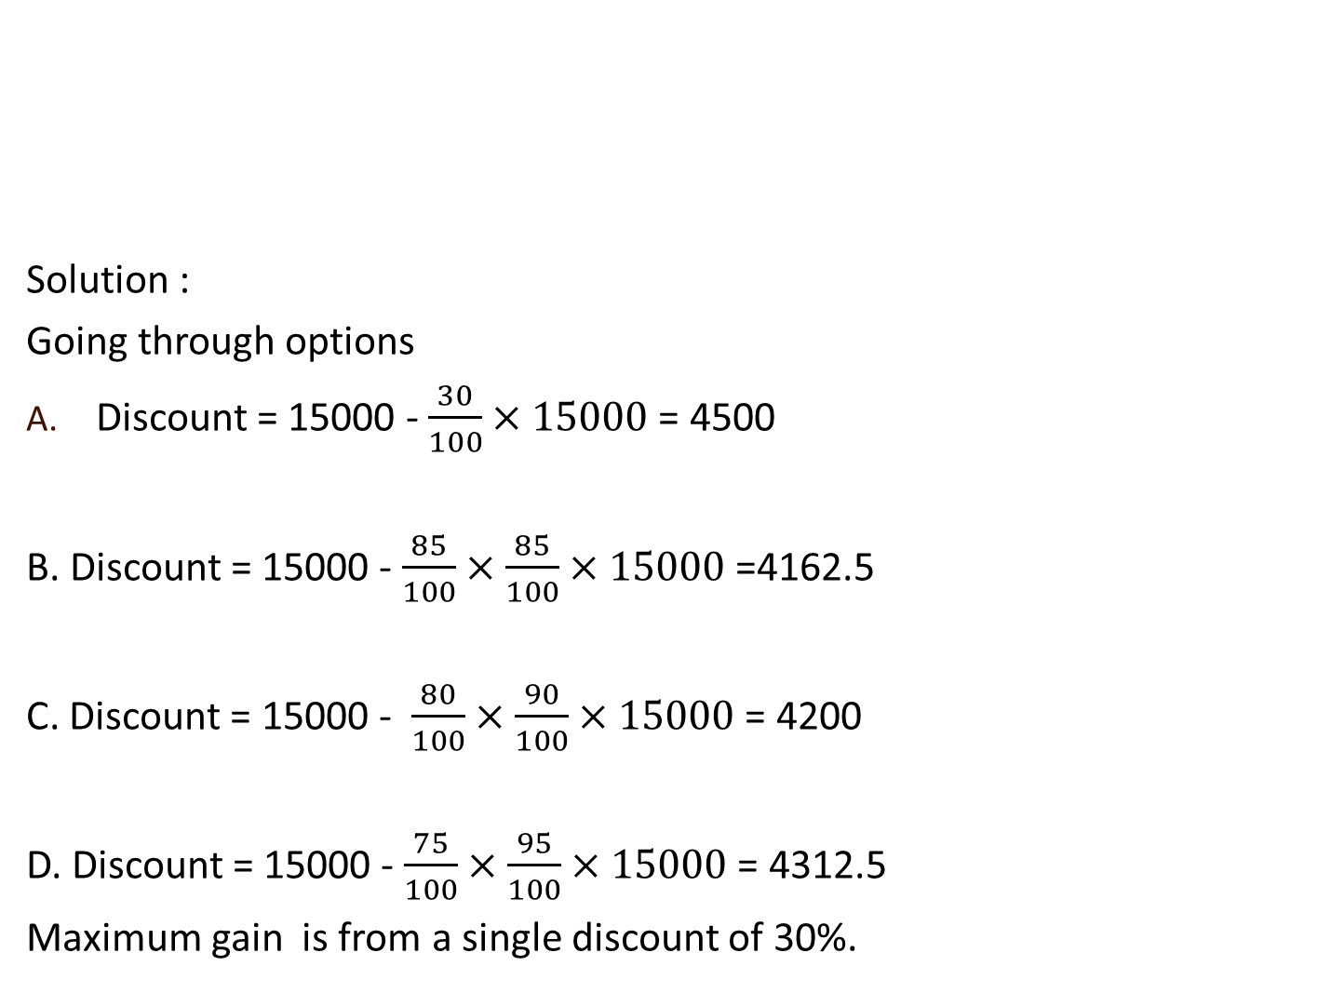
Solution :
Going through options
Discount = 15000 - $\frac{30}{100}×15000$ = 4500
B. Discount = 15000 - $\frac{85}{100}×\frac{85}{100}×15000$ =4162.5
C. Discount = 15000 - $\frac{80}{100}×\frac{90}{100}×15000$ = 4200
D. Discount = 15000 - $\frac{75}{100}×\frac{95}{100}×15000$ = 4312.5
Maximum gain is from a single discount of 30%.
Aruna goes to a shop to purchase a mobile priced Rs. 15000. She is offered 4 discount options by the shopkeeper. Which of these options should she opt for to gain maximum advantage of the discount offered?
Single discount of 30% B. 2 successive discount of 15% each
C. 2 successive discount of 20% and 10% D. 2 successive discount of 25% and 5%

Slide 15

Solution :
Given, profit = 20%, Difference between SP and CP = Rs. 240
$$Profit\%= \frac{SP−CP}{CP}×100$$
$$20=\frac{240}{CP}×100$$
CP = 120 × 100 = 1200
Therefore, SP = 1200 + 240 [Because SP – CP = 240]
SP = 1440.
The difference between the cost price and sale price of an article is Rs. 240. If the profit is 20%, the selling price is

Slide 16
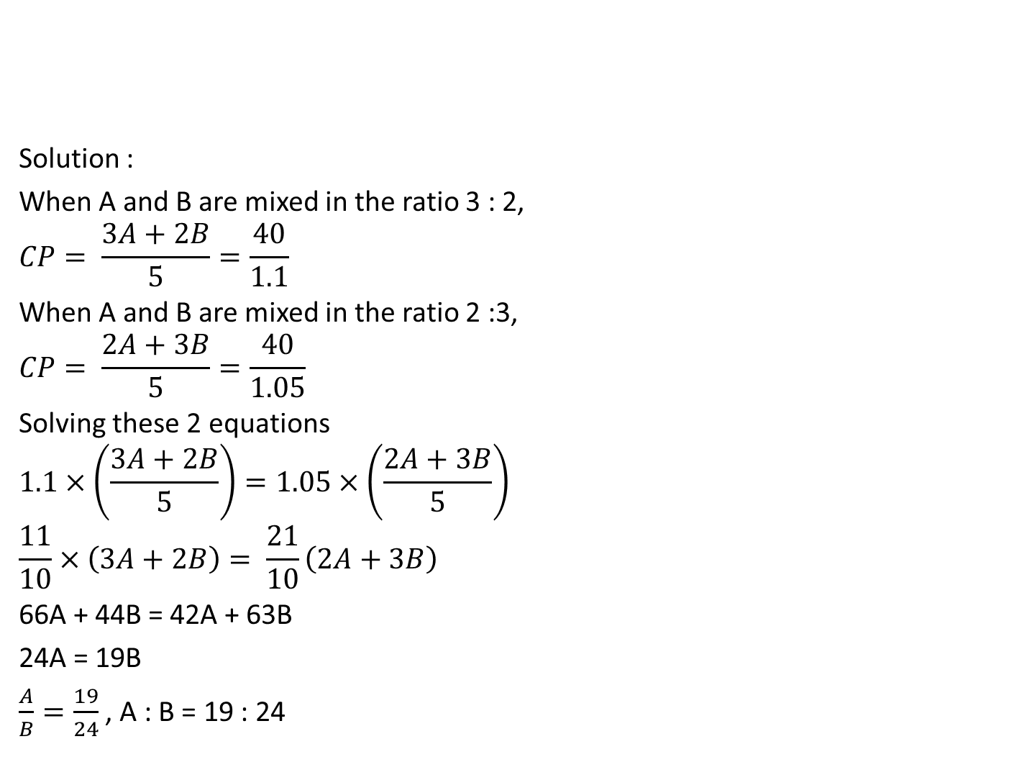
Solution :
When A and B are mixed in the ratio 3 : 2,
$$CP= \frac{3A+2B}{5}=\frac{40}{1.1}$$
When A and B are mixed in the ratio 2 :3,
$$CP= \frac{2A+3B}{5}=\frac{40}{1.05}$$
Solving these 2 equations
$$1.1×\left(\frac{3A+2B}{5}\right)=1.05×\left(\frac{2A+3B}{5}\right)$$
$$\frac{11}{10}×\left(3A+2B\right)= \frac{21}{10}\left(2A+3B\right)$$
66A + 44B = 42A + 63B
24A = 19B
$\frac{A}{B}=\frac{19}{24}$ , A : B = 19 : 24
Two types of tea, A and B, are mixed and then sold at Rs. 40 per kg. The profit is 10% if A and B are mixed in the ratio 3 : 2, and 5% if this ratio is 2 : 3. The cost prices, per kg, of A and B are in the ratio

Slide 17


